Slide 1

Depression Detection
Satyam Kumar - 1906204
Utkarsh Prasad- 1906222
Ishan Basak - 1906178
Rohan Banerjee - 1906194

Slide 2
Introduction
More than 300 million people suffer from depression and only a fraction receive adequate treatment. Depression is the leading cause of disability worldwide and nearly 800,000 people every year die due to suicide.
Social media provides an unprecedented opportunity to transform early depression intervention services, particularly in young adults.

Slide 3
Why Depression detection ?
By building an algorithm that can analyze Tweets exhibiting self-assessed depressive features, it will be possible for individuals, parents, caregivers, and medical professionals to analyze social media posts for linguistic clues that signal deteriorating mental health far before traditional approaches currently do.
With this project, We are working to expand the scope of social media-based mental health measures and use existing research that has proven the correlation between depression and specific linguistic features in order to build an algorithm that can predict text-based signs of depression.

Slide 4
Data Set
Twitter can provide information not available anywhere else. Aside from the standard information released by official company accounts, Twitter also offers personal insights and observations of employees and even people in the right place at the right time.
Kaggle - Kaggle allows user to find the data set and build model.

Slide 5
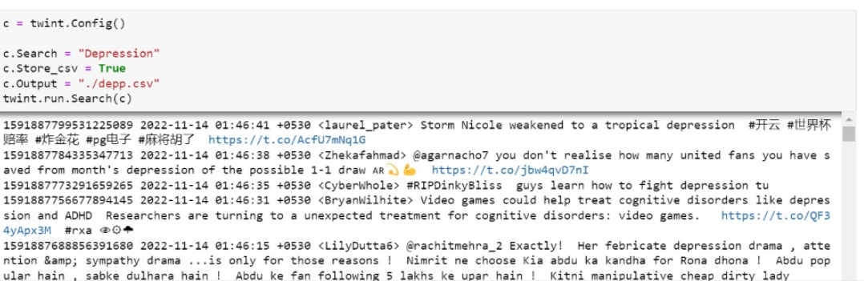
Scrapping Data from Twitter
Twitter API can provide only 3200 tweet only at a time.
Twint is an advanced Twitter scraping tool written in Python that allows for scraping Tweets from Twitter.

Slide 6
It scrape Tweets from specific user and tweets relating to certain topics, hashtags & trends or sort out sensitive information from Tweets like e-mail and phone numbers.
It search the tweet , limit the tweet, change the language of tweet, and we can add the date and time .

Slide 7
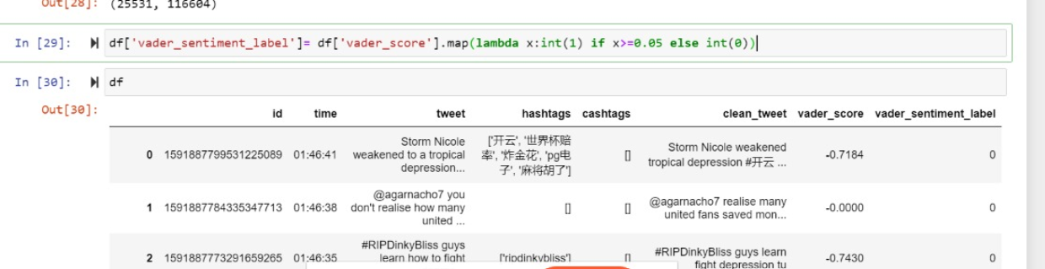
Vander Analysis
To get the Target value of the scrapped data we use the vander analysis.
VADER analysis calculates the sentiment score of an input text.

Slide 8
This Project utilizes a number of libraries, including Matplotlib, NumPy, and more. These libraries can easily be downloaded and documentation is available on the official sites..
This model utilizes:
Matplotlib pip install matplotlib
Pandas pip install pandas
NumPy pip install numpy
Scikit-Learn conda install scikit-learn
Keras pip install keras
NLTK pip install --user -U nltk

Slide 9
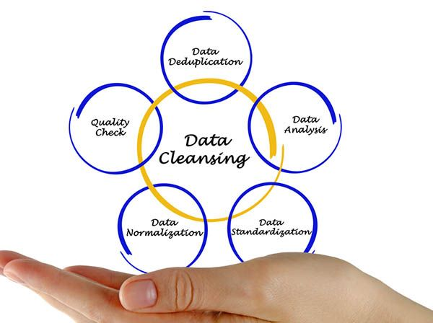
Data Cleaning
Data cleaning is the process of fixing or removing incorrect, corrupted, incorrectly formatted, duplicate, or incomplete data within a dataset.
Data cleaning is one of the important parts of machine learning. It plays a significant part in building a model.

Slide 10
Why data Cleaning ?
Data cleaning increases overall productivity and allow for the highest quality information in your decision-making. Benefits include: Removal of errors when multiple sources of data are at play. Fewer errors make for happier clients and less-frustrated employees.
Regardless of how sophisticated your ML algorithm is, you can't obtain good results from bad data. Depending on the dataset, different procedures and methods will be used to clean the data. As a result, no single guide could possibly address every situation you might encounter.

Slide 11

Outlier Detection
Outlier detection technique (ODT) is used to detect anomalous observations/samples that do not fit the typical/normal statistical distribution of a dataset. Simple methods for outlier detection use statistical tools, such as boxplot and Z-score, on each individual feature of the dataset.

Slide 12
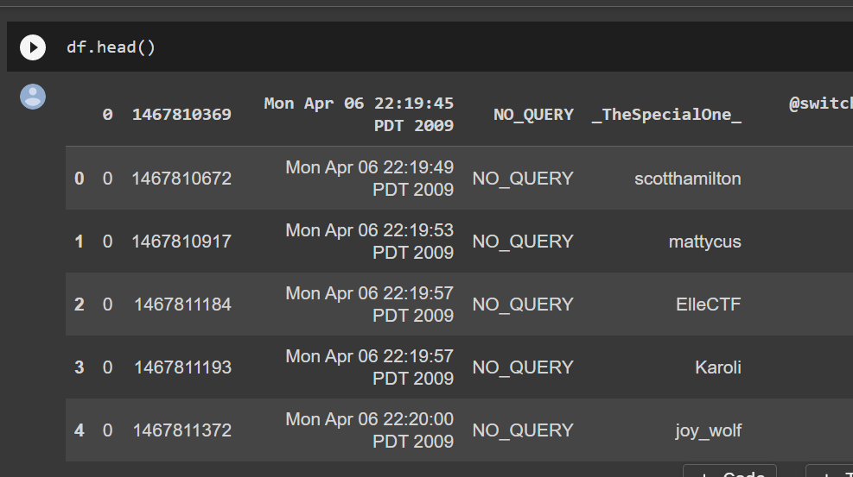
EDA (Exploratory Data Analysis)
Exploratory Data Analysis refers to the critical process of performing initial investigations on data so as to discover patterns,to spot anomalies,to test hypothesis and to check assumptions with the help of summary statistics and graphical representations.

Slide 13
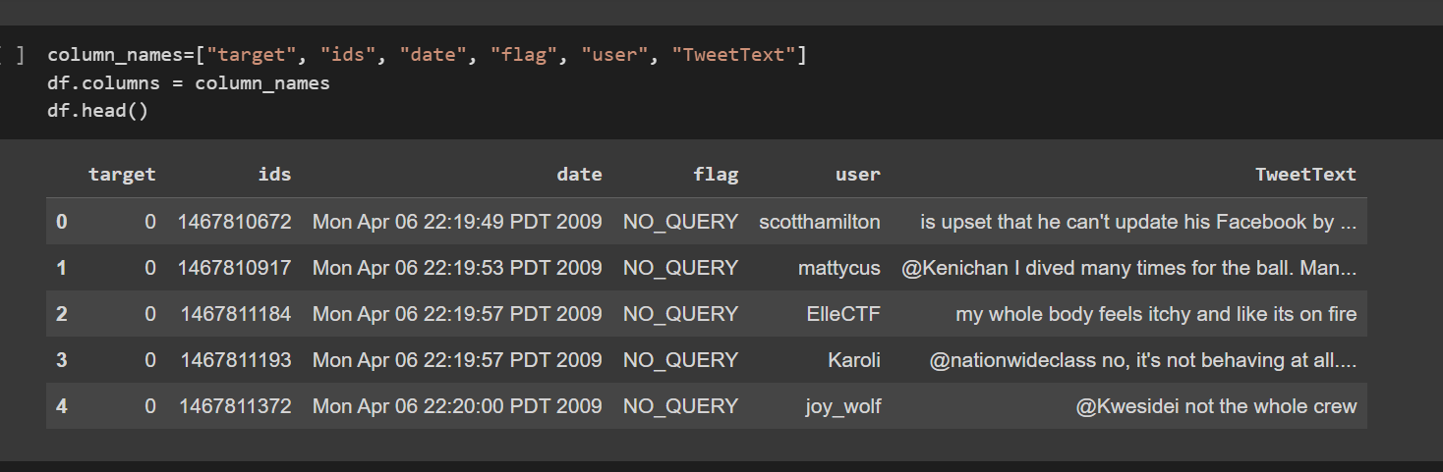
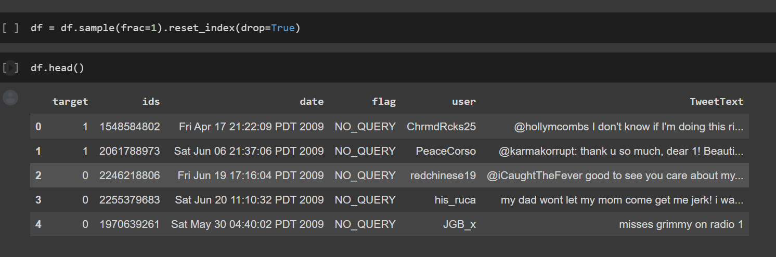

Slide 14
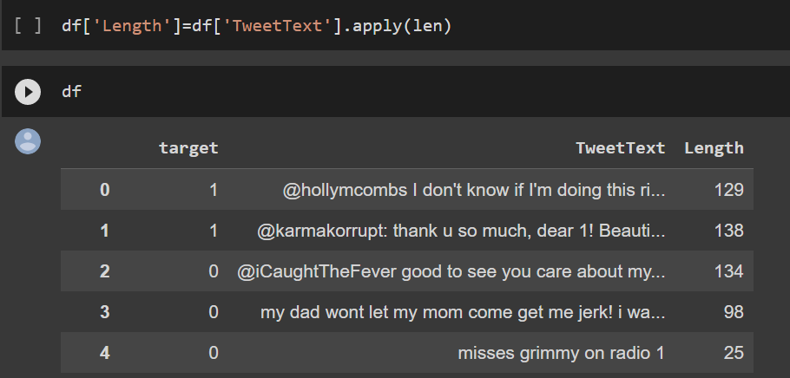
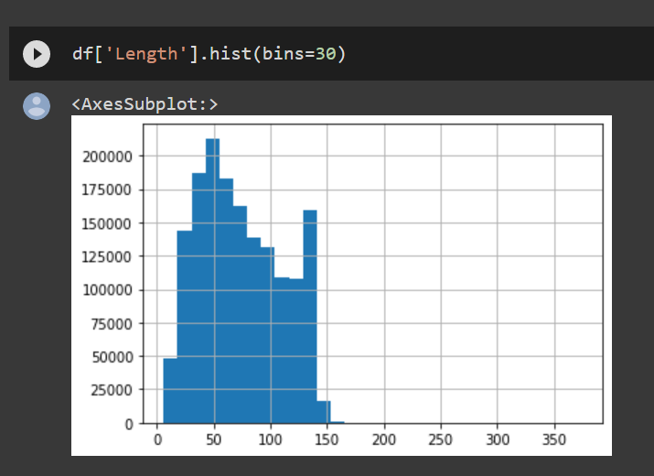
Since your data has no length column we will add a length column for every tweet So that we can extract some information .
Now will plot the histogram of length column

Slide 15
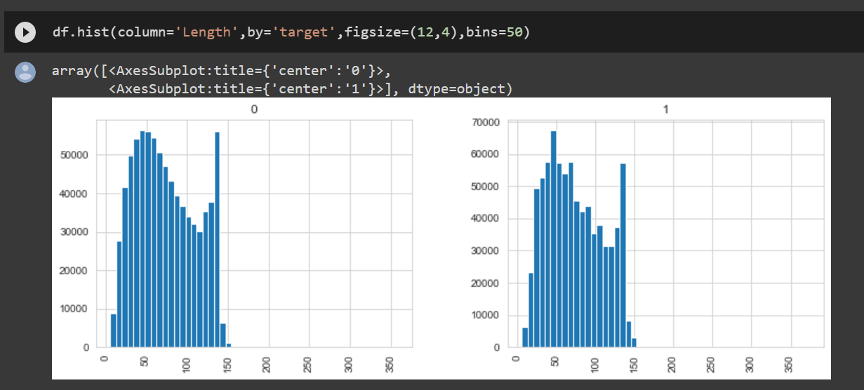
Graphical Comparison b/w Positive Tweet(1) and Negative Tweet(0)
Here we will plot the histogram of the target value.

Slide 16
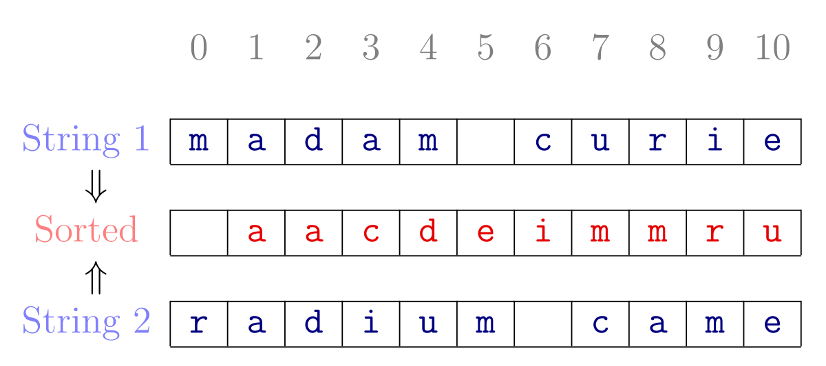
Text Normalization
Text normalization is the process of transforming text into a single canonical form that it might not have had before.
Normalization is helpful in reducing the number of unique tokens present in the text, removing the variations in a text

Slide 17
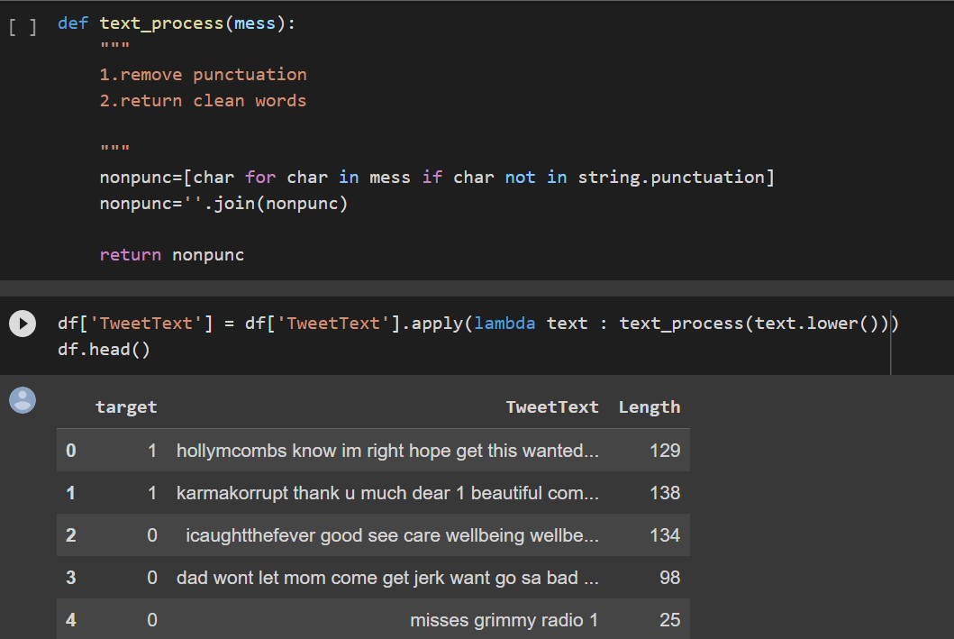
Removing of Punctuation
Why we need to remove punctuation from string ?
Punctuations are special symbols that add grammatical structure to natural English. Natural English strings are not easily processed; hence we need to remove punctuation from strings before we can use them for further processing

Slide 18
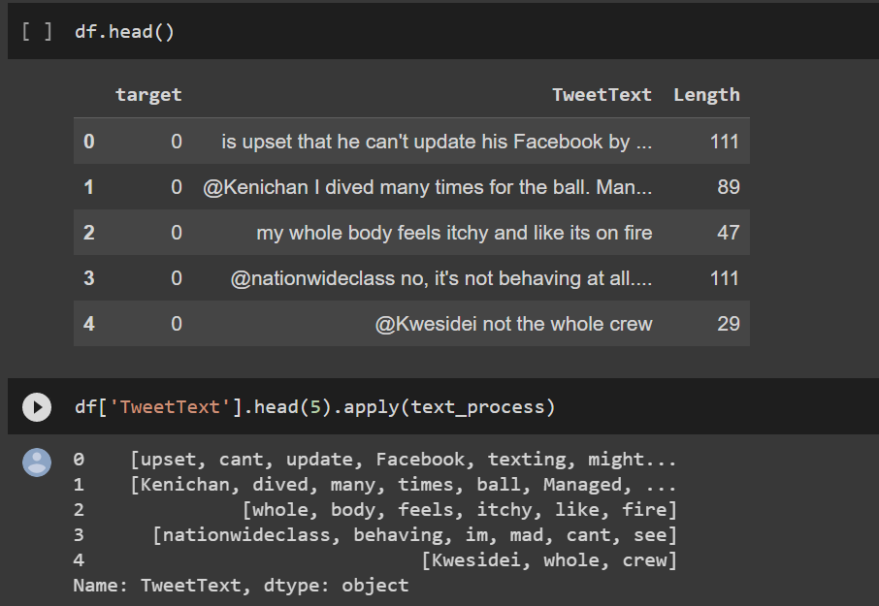
Removing stop Words
A stop word is a commonly used word (such as “the”, “a”, “an”, “in”) that a search engine has been programmed to ignore, both when indexing entries for searching and when retrieving them as the result of a search query. We would not want these words to take up space in our database, or taking up valuable processing time.

Slide 19
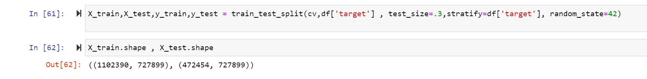
Data Splitting
We need to split our data into two sets: Training and Testing sets.
Train Data is data used in order to build and train our classification model.
Test Data is data, that our classifier model has never seen before, used in order to assert the accuracy and test our classification model.

Slide 20
Count Vectorization Process
Natural Language Processing allows us to convert the text we want to analyze and preprocess them into features to be put into our model
There are methods that can be used in the Natural Language Processing toolbox that can be used to preprocess our text: Count Vectorization and Term Frequency-Inverse Document Frequency.
Count Vectorization involves counting the number of occurrences each words appears in a document (i.e distinct text such as an article, book, even a paragraph!). Python’s Sci-kit learn library has a tool called CountVectorizer to accomplish this.

Slide 21
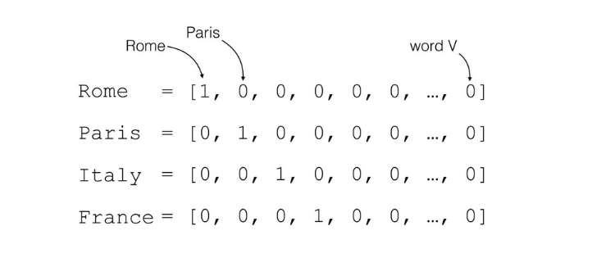

Slide 22
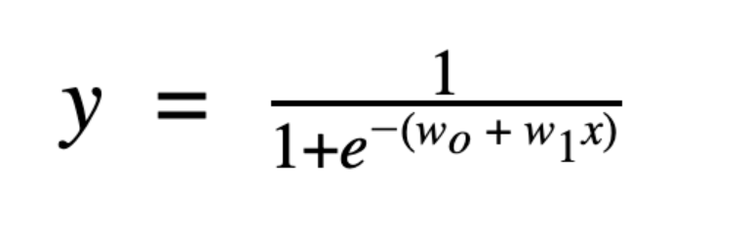
Machine Learning Model
Logistic Regression- Logistic regression is a machine learning algorithm used to predict the probability that an observation belongs to one of two possible classes.
1/(1+e^-z) is the sigmoid function.
wo + w1x is the linear model within logistic regression.

Slide 23
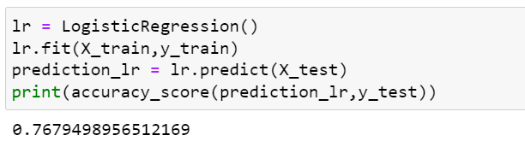
The logistic functions (also known as the sigmoid functions) convert the probabilities into binary values which could be further used for predictions.
Logistic regression uses functions called the logit functions,that helps derive a relationship between the dependent variable and independent variables by predicting the probabilities or chances of occurrence.

Slide 24
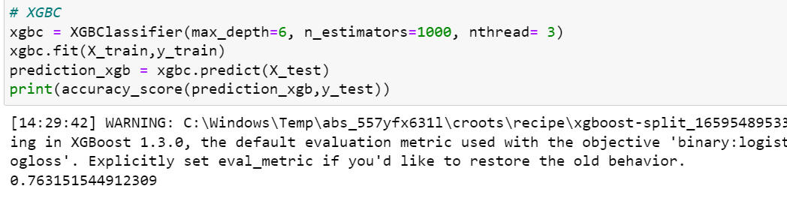
XGBClassifier
The XGBoost stands for eXtreme Gradient Boosting, which is a boosting algorithm based on gradient boosted decision trees algorithm. XGBoost applies a better regularization technique to reduce overfitting, and it is one of the differences from the gradient boosting.

Slide 25
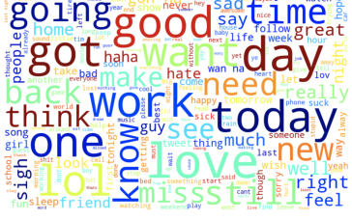
Conclusion
The analysis of depression has enormous potential. Depression can so quickly be seen in text, even without the use of complex models. Simply by collecting, cleaning, and processing available data, visual analysis alone can illuminate the difference between random Tweets and Tweets that have depressive characteristics.
Random Tweets

Slide 26
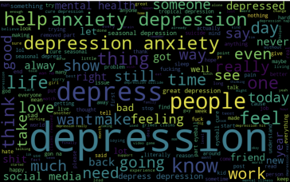
The potential of linguistic analysis in the arena of mental health cannot be overstated. By analyzing a person’s words, you have a clear and valuable window into his or her mental state. Even the simplest analysis of social media can provide us with unprecedented access into individuals thoughts and feelings and lead to substantially greater understanding and treatment of mental health
Tweets with Depressive Characteristics

Slide 27
THANK YOU

